Slide 1
Generations Of Computer

Slide 2
PRESENTED BY AND DESIGNED
Presentation Point check out link below for more presentations (www.presentationpoint.yolasite.com)
IDEA BY:
FUTURE IT (www.futureit.yolasite.com)
SUPPORTED BY:
www.exploretomorrow.blogspot.com

Slide 3
COMPUTER?

Slide 4
Artificial Intelligence
Vacuum tubes
Microprocessors
Integrated Circuits
Transistors

Slide 5
First Generation (1945-1956)
The first Generation computers used vacuum tubes for circuitry and magnetic drums for memory.
They were expensive and used to take entire rooms.
They used a lot of electricity, which generated a lot of heat and caused malfunctions.
First generation computers relied on machine language, the lowest-level programming language understood by computers, and it could only solve One problem at a time.
Input was based on punched cards and paper tape, and output was displayed on printouts.
The UNIVAC and ENIAC computers are examples of first-generation computing devices.
ENIAC : “Electronic Numerical Integrator And Computer”
UNIVAC: “Universal Automatic Computer”

Slide 6
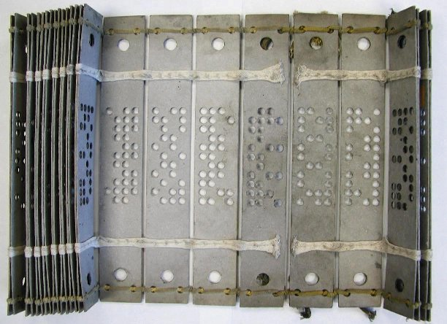
Vacuum tubes Punched Cards

Slide 7
ENIAC

Slide 8
ENIAC
ENIAC Contained approximately 17,468 vacuum tubes, 7,200 crystal diodes, 1,500 relays, 70,000 resistors, 10,000 capacitors and around 5 million hand-soldered joints.
It weighed somewhere like 30 short tons (27 t).
It consumed somewhere around 150 kW of power.
ENIAC is reliable, programmable.
ENIAC is not as easy and user friendly as the modern day computers.

Slide 9
Second Generation (1956-1963)
Transistors replaced vacuum tubes and ushered in the second generation of computers.
Transistors allowed computers to become smaller, faster, cheaper, more energy-efficient and more reliable than their first-generation predecessors.
The transistor generated a great deal of heat that subjected the computer to damage but still it was a vast improvement over the vacuum tube.
Second-generation computers moved from machine language to symbolic, or Assembly language, which allowed programmers to specify instructions in words.
These were the first computers that stored their instructions in their memory, which moved from a magnetic drum to magnetic core technology.

Slide 10
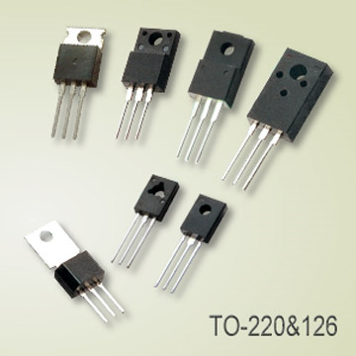
Transistors

Slide 11
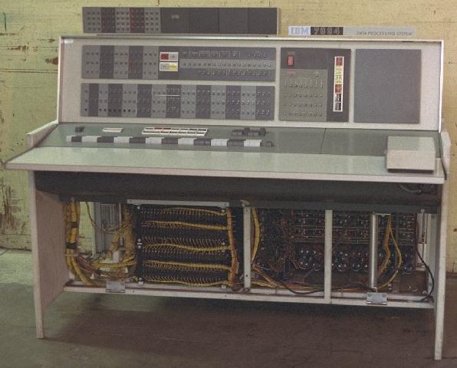
Second Generation Computer

Slide 12
Third Generation (1964-1971)
The development of the integrated circuits was the hallmark of the third generation of computers.
Transistors were miniaturized and placed on silicon chips, called semiconductors, which drastically increased the speed and efficiency of computers.
Instead of punched cards and printouts, users interacted with third generation computers through keyboards and monitors and interfaced with an operating system.
Operating System allowed the device to run many different applications at one time with a central program that monitored the memory.
Computers for the first time became accessible to a mass audience because they were smaller and cheaper than their predecessors.

Slide 13
Integrated Circuit

Slide 14
Third Generation Computer

Slide 15
Fourth Generation (1971-present)
The microprocessor brought the fourth generation of computers.
In the world of personal computers, the terms microprocessor and CPU are used interchangeably.
What in the first generation filled an entire room could now fit in the palm of the hand.
A microprocessor can move data from one memory location to another.
Three basic characteristics differentiate microprocessors
Instruction Set
Bandwidth
Clock Speed
Two typical components of a CPU (processor) are:
The arithmetic logic unit (ALU)
The control unit

Slide 16
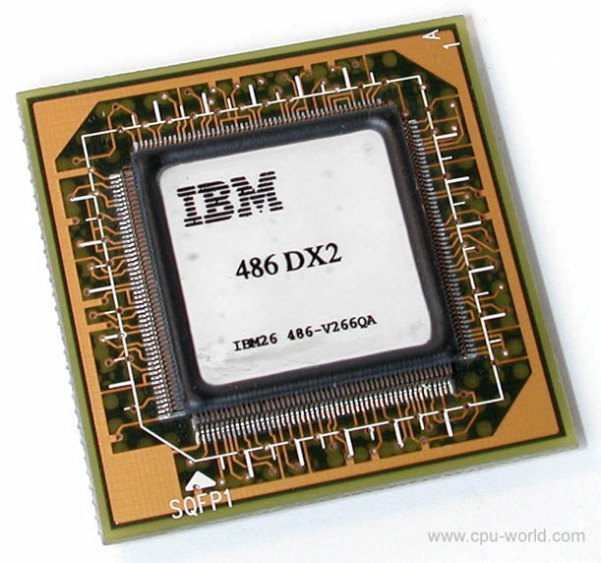
AMD Microprocessor IBM Microprocessor

Slide 17
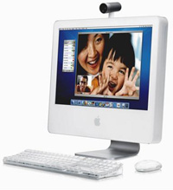
Fourth Generation Computers

Slide 18
Fifth Generation (Present And Beyond)
Fifth generation computing devices, based on artificial intelligence, are still in development. Though there are some applications, such as voice recognition, that are being used today.
Artificial intelligence includes:
Games Playing
Expert Systems
Natural Language
Neural Networks
Robotics
There are several programming languages that are known as AI languages because they are used almost exclusively for AI applications. The two most common are LISP and Prolog.

Slide 19
Voice Recognition

Slide 20
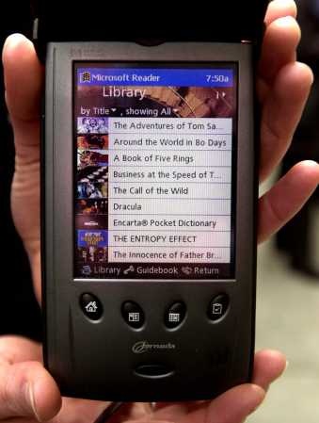
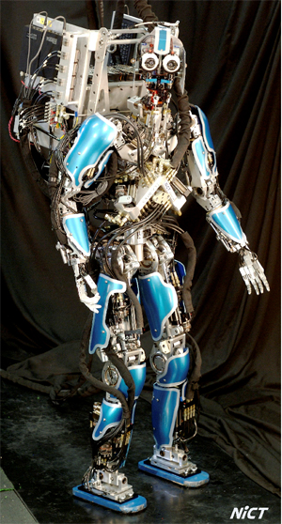
Fifth Generation Computers

